Slide 1
Multi-Product Dynamic Pricing and Inventory Control
Notes:
Motivation
Need -> Better testing, use past information better and understanding your customers

Slide 2
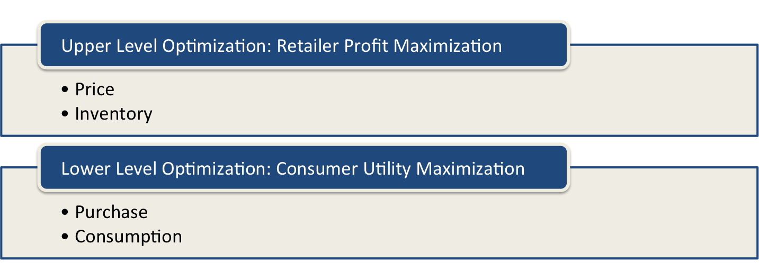
Multi-Product Dynamic Pricing and Inventory Control
Notes:
Model Approach – Upper and Lower Level
Methodology – Optimal Control, rational expectations equilibrium, NLP; Estimation – Structural Equation Modeling ..

Slide 3
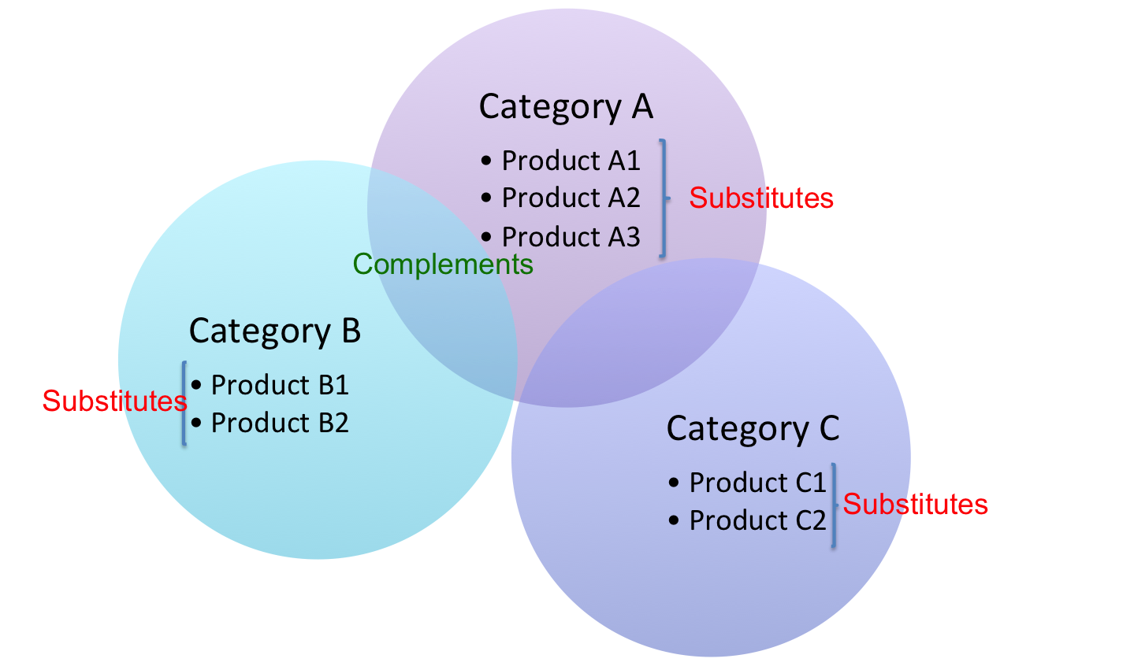
Multi-Product Dynamic Pricing and Inventory Control

Slide 4

Multi-Product Dynamic Pricing and Inventory Control

Slide 5
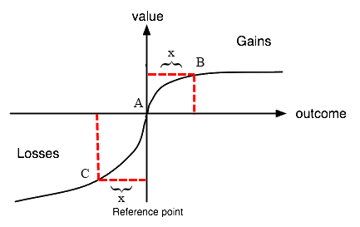
Multi-Product Dynamic Pricing and Inventory Control

